Slide 1
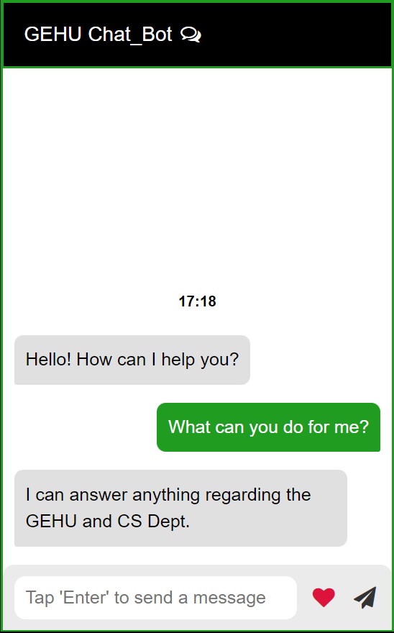
MINI PROJECT III SEM
Intelligent Chat-Bot
For GEHU and CSE Department
By: MAYANK RAWAT

Slide 2
MINI PROJECT III SEM
I present to you, an intelligent Chat-Bot entirely
Made from culmination of HTML, CSS and
JavaScript.
This uses basic concepts from all three languages
And fetches data from an external JSON file to
Provide output.
Now we will see the both Back and Front end code
Of the Chat-Bot and how it shapes the project.

Slide 3
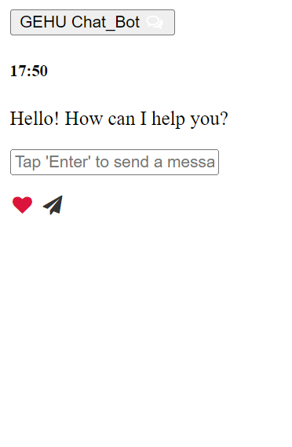
MINI PROJECT III SEM
Stripped off all its CSS, this is what the Chat-Bot
Looks like with raw HTML.
The HTML is used to derive the structure of the
Chat-Bot. HTML forms the backbone of most of the
Web pages and provides a way to organize and
Format text, images, forms and other elements
On a web page.
I used Font-Awesome library to add the skin for the
Interactive Buttons of the Chat-Bot.

Slide 4
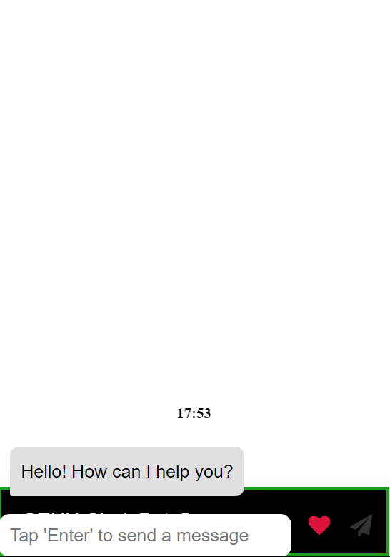
MINI PROJECT III SEM
User Interface is the only thing that is visible
To the client and the users once the development
Concludes. This is one of the most important
Aspects of a project. Without a good and intelligible
Interface, even the best Web Page would not be
Preferable.
CSS allows us to transform our raw HTML page
Into something more presentable and elegant.

Slide 5
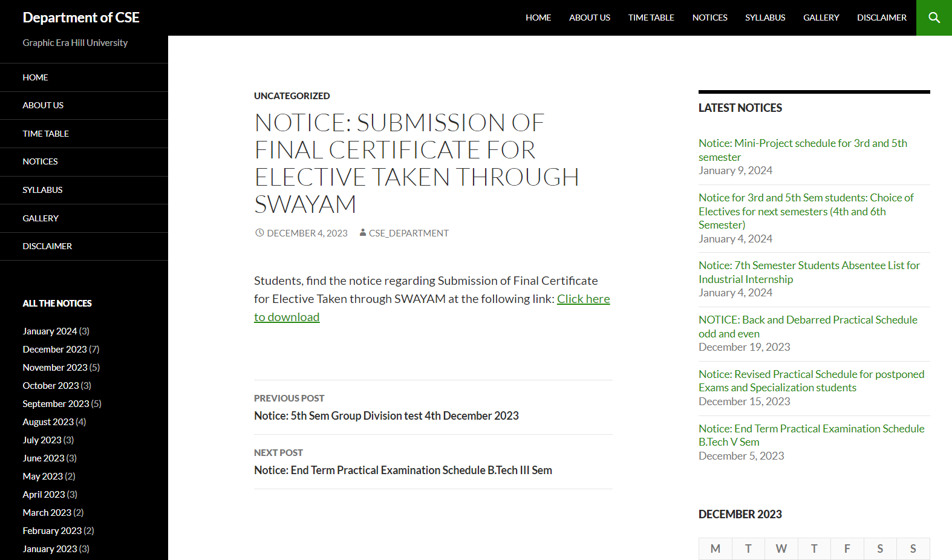
MINI PROJECT III SEM
User Interface for this project is designed specifcally for the btechcsegehu.in
the official website for the Department of CSE GEHU

Slide 6
MINI PROJECT III SEM
JavaScript allows developers to create a dynamic and interactive web page to interact with visitors and execute complex actions.
Here JavaScript is used to get user response and returns an appropriate answer. The answers are fetched via a JSON file.
JavaScript also give the various buttons like send and heart their functions. It is also used to display the current time on top of the Chat.

Slide 7
MINI PROJECT III SEM
JavaScript is also used to make the slide up animation. This merges the two separate states of the web page (Collapsible and Full designed using CSS) and creates the smooth animation.
This keeps the Chat-Bot out of view until required and only appears when clicked on. This insures that no important detail of the web page is Obstructed by the Chat-Bot.

Slide 8
MINI PROJECT III SEM
An external JSON file is used to store all the responses. The responses are fetched accordingly by the “getHardResponse” function which takes the string provided by the user and responds to it accordingly.
{
"hello": "Hello there!",
"goodbye": "Talk to you later!",
"greeting": "Greetings! How can I help you?",
}

Slide 9
MINI PROJECT III SEM
What can be improved further?
A text recognition function can be added that can compare similarities to fetch answers instead of writing one for every individual input.
We can also extract the user data from the Chat-Bot to further enhance the user experience.
We can add even more depth to the Chat-Bot by utilizing AI. Such a way, users can have their queries regarding any aspect of their academics answered.

Slide 10
MINI PROJECT III SEM
Conclusion
Summarizing the key takeaways from our exploration of crafting an interactive chat-bot. We are emphasizing the significance of leveraging HTML, CSS and JavaScript for seamless user engagement and the potential for driving enhanced user experiences.
Thank You.

